Slide 1

AGRICULTURE PROJECT

Slide 2
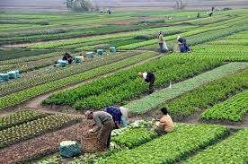
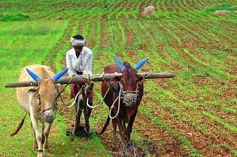
OBJECTIVE
This project is used to extract information from agriculture data and to give suggestions regarding crops and make future decisions so that agriculture can be carried out in a planned manner.

Slide 3
TECHNOLOGIES USED
AWS S3
AWS Glue
AWS Crawler
AWS Wrangler
AWS Redshift
AWS Lambda
PySpark
Spark SQL

Slide 4
SCHEMA DIAGRAM

Slide 5
PROBLEM STATEMENTS
Finding trends in crops in terms of production, area.
State wise suicide rate of the farmers
Which year has Highest cultivation of Pulses
Which year has Highest cultivation among rice, wheat and coffee.
Which state yields highest crop per year?
Finding how different factors like temperature affect production
Year wise suicide rates of farmers
Which state receives highest rainfall in which year and what is the annual rainfall?
Crop wise cost of cultivation versus cost of production
Highest crop production in particular season.

Slide 6
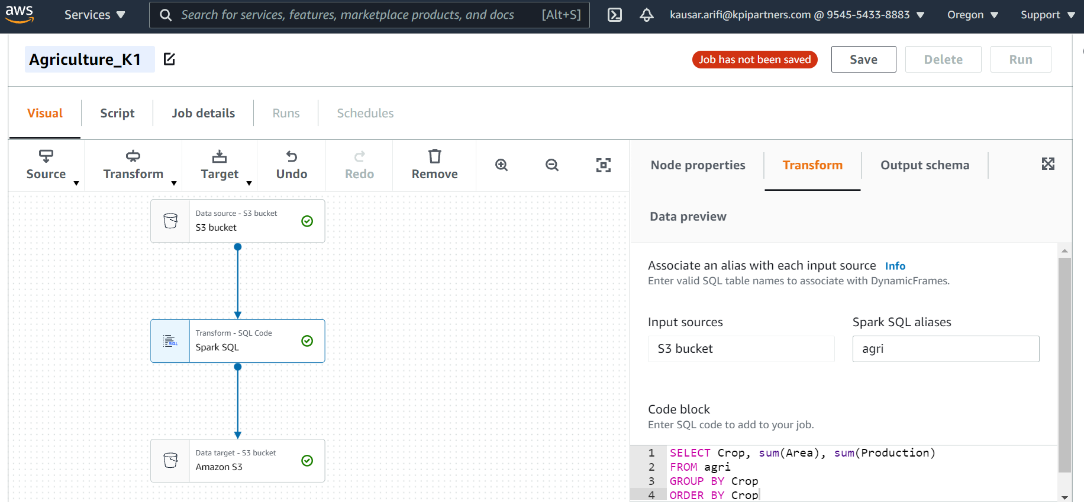
1. Finding trends in crops in terms of production, area.

Slide 7
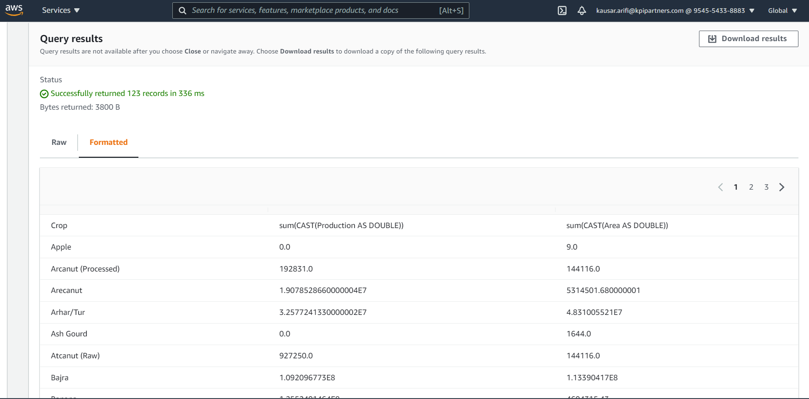
Output:

Slide 8
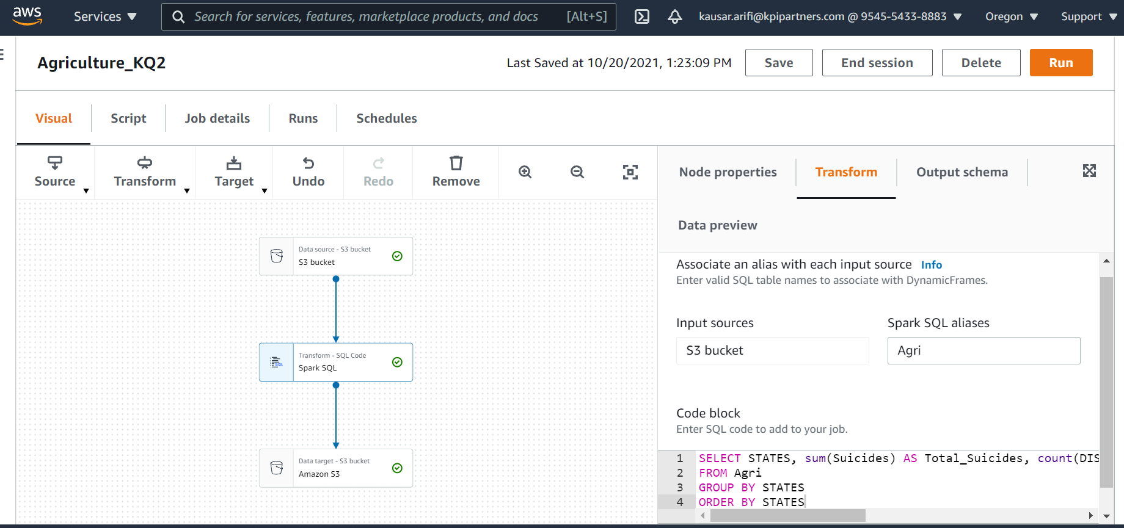
2. State wise suicide rate of the farmers

Slide 9
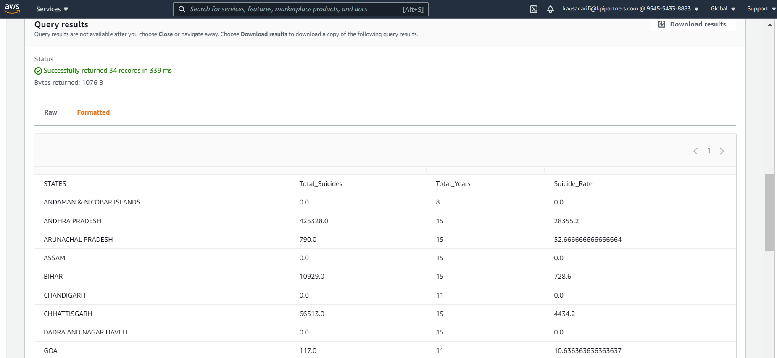
Output:

Slide 10
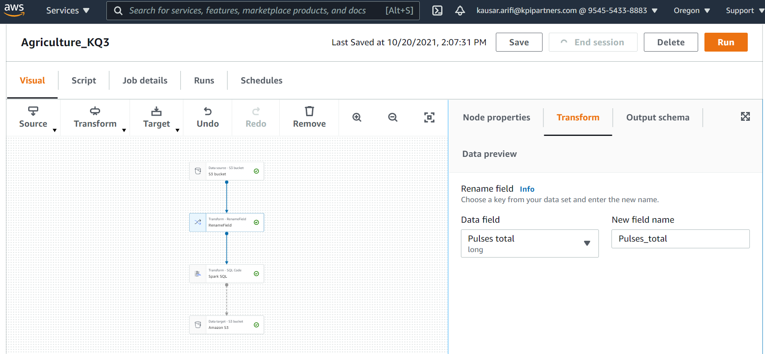
3. Which year has Highest cultivation of Pulses

Slide 11
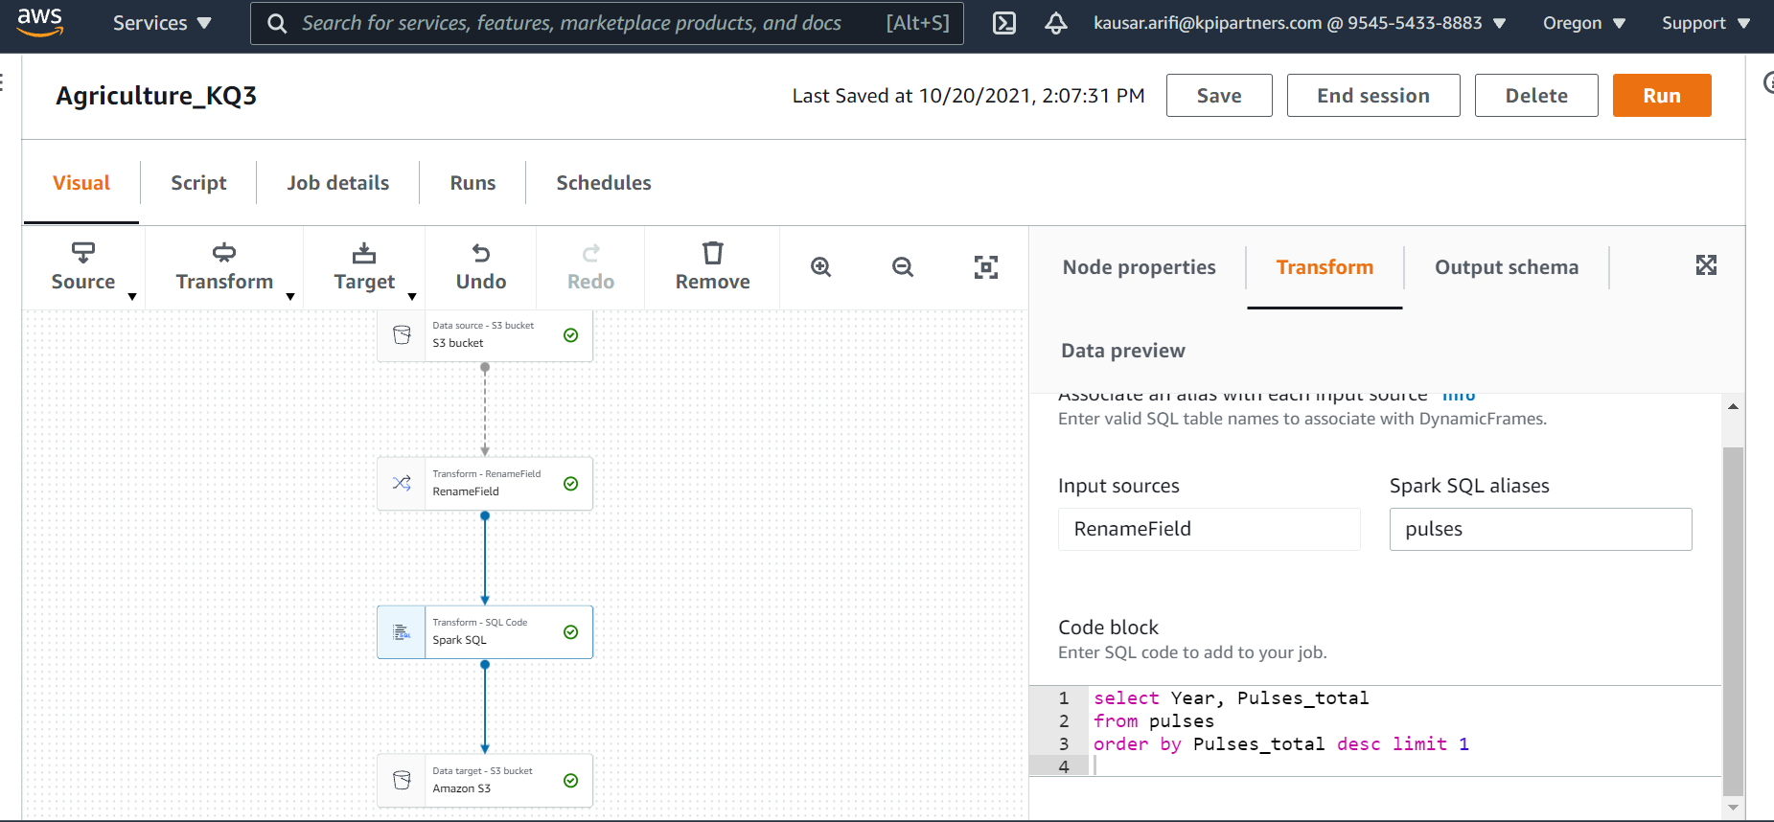
Cont..

Slide 12
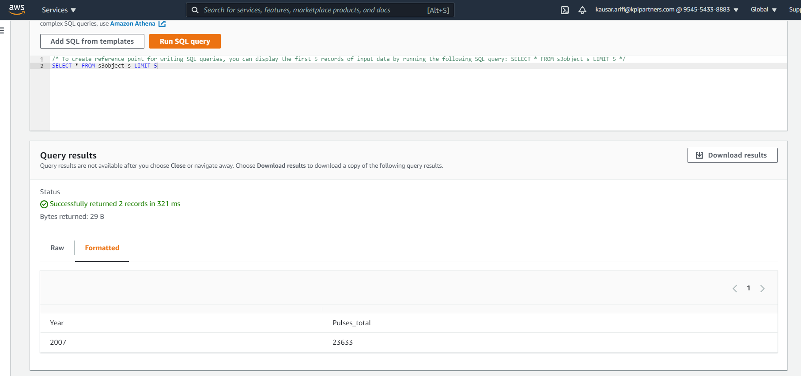
Output:

Slide 13
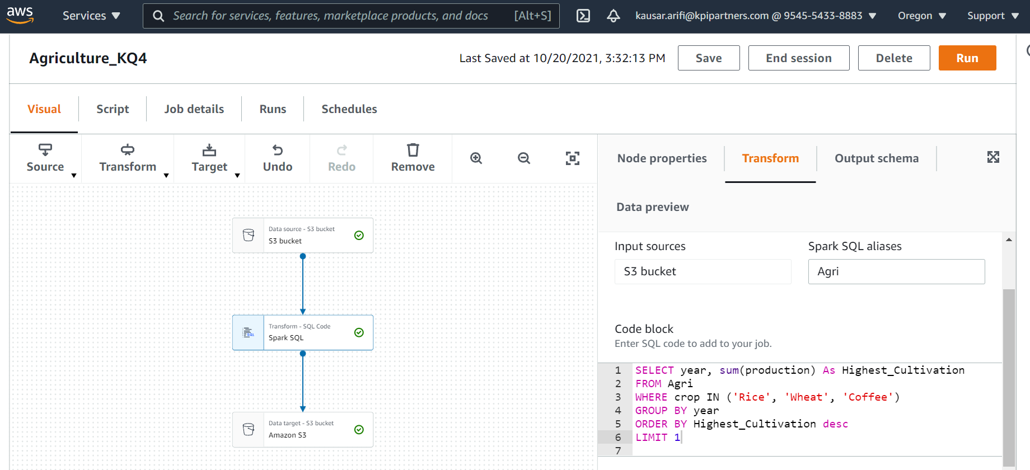
4.Which year has Highest cultivation among rice, wheat and coffee.

Slide 14
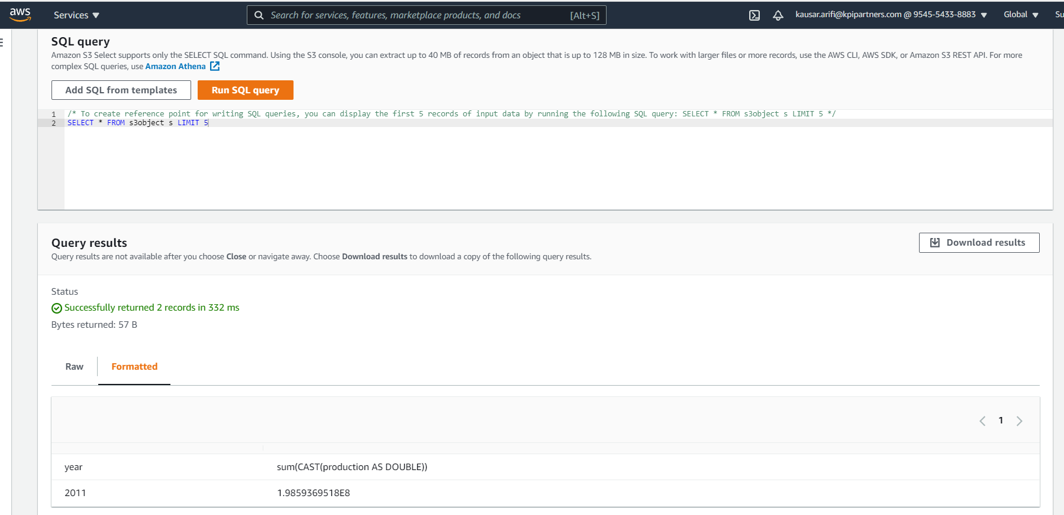
Output:

Slide 15
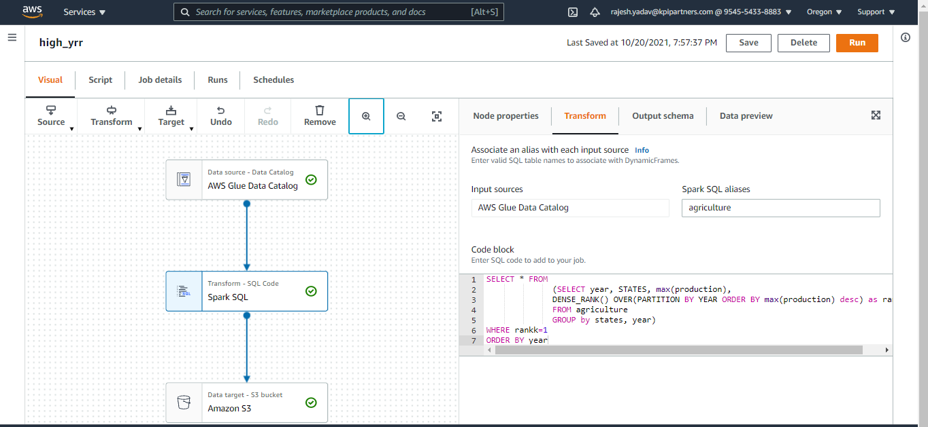
5. Which state yields highest crop per year?

Slide 16
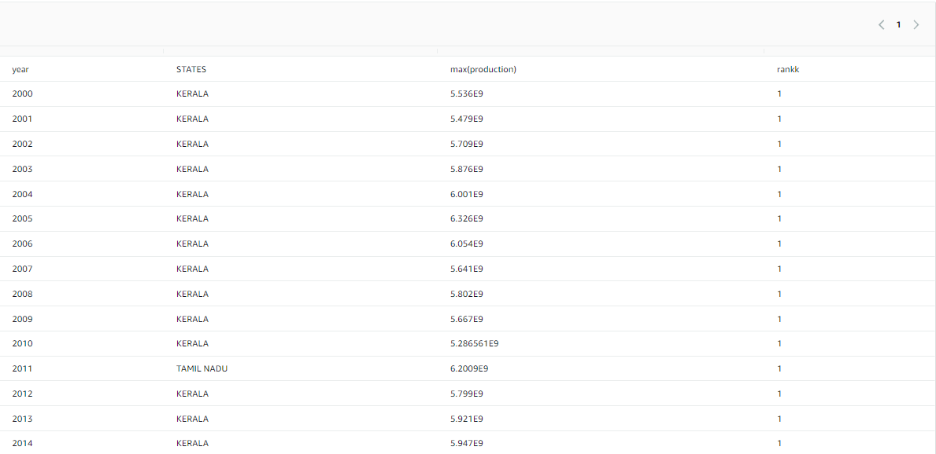
Output:

Slide 17
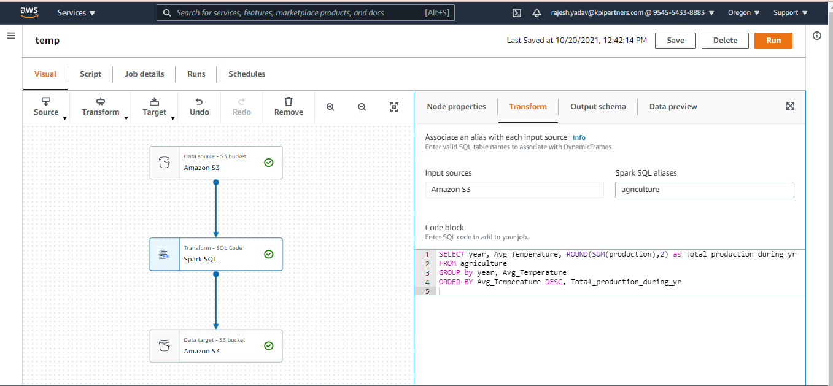
6. Finding how different factors like temperature affect production

Slide 18
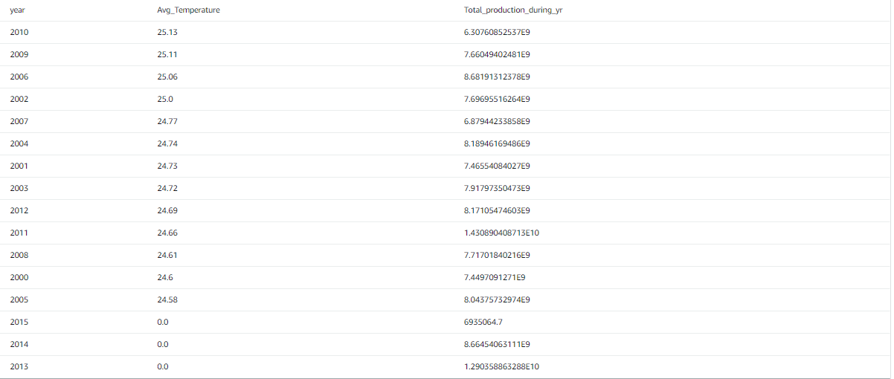
Output:

Slide 19
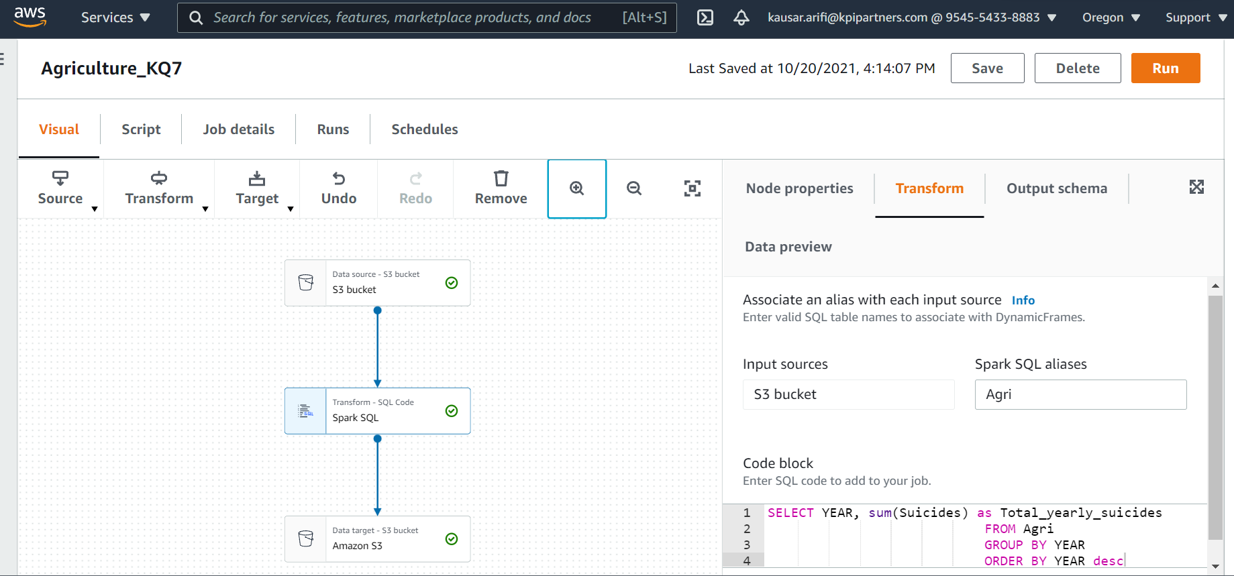
7. Year wise suicide rates of farmers

Slide 20
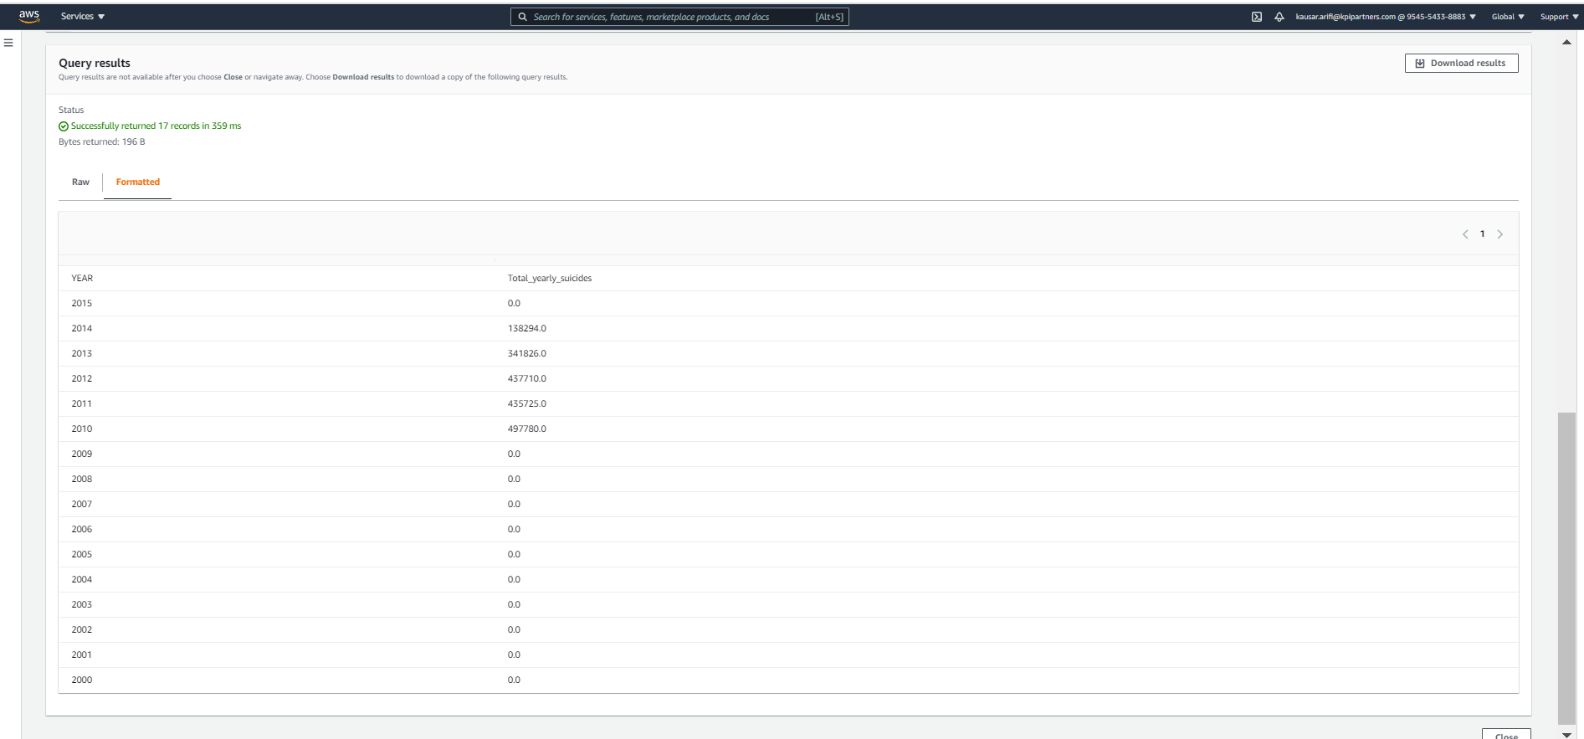
Output:

Slide 21
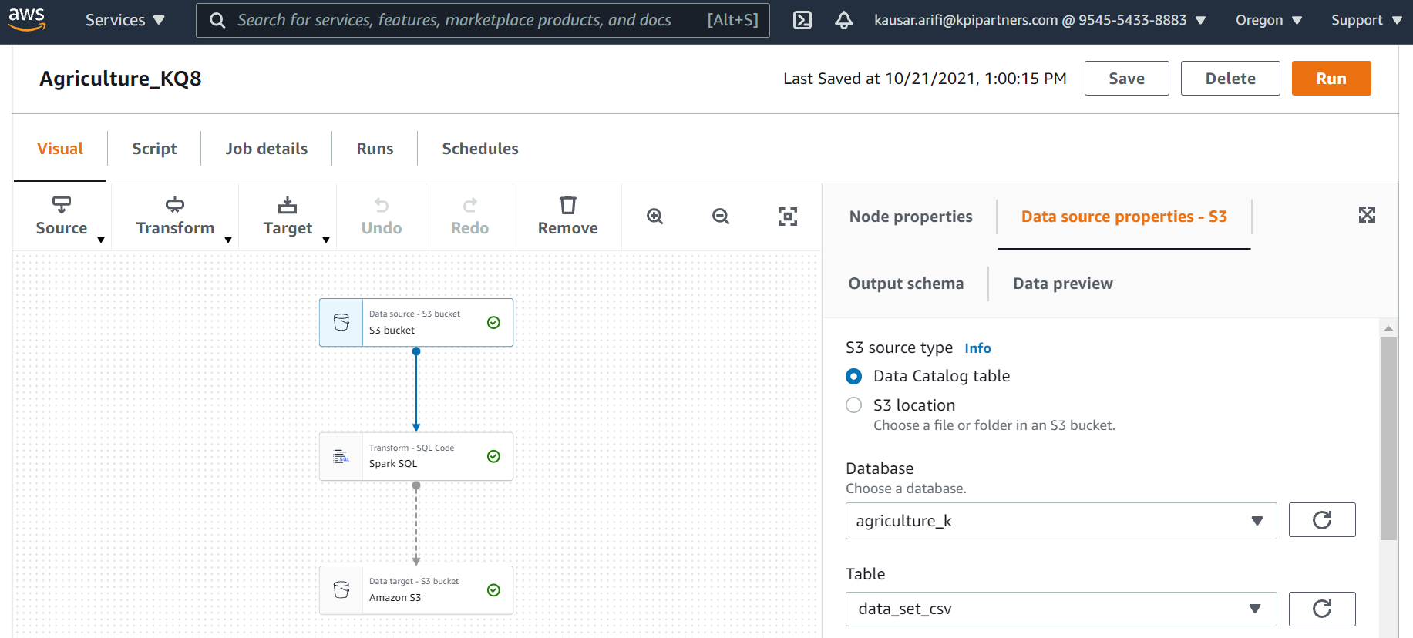
8. Which state receives highest rainfall in which year and what is the annual rainfall?

Slide 22
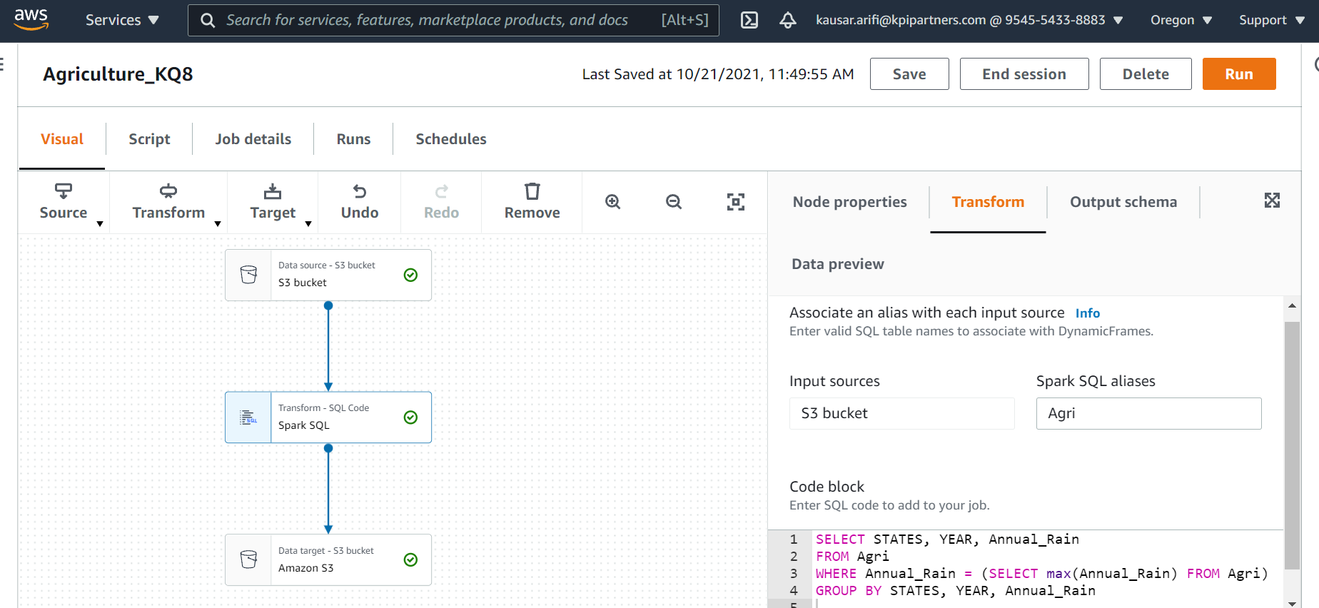
Cont..

Slide 23
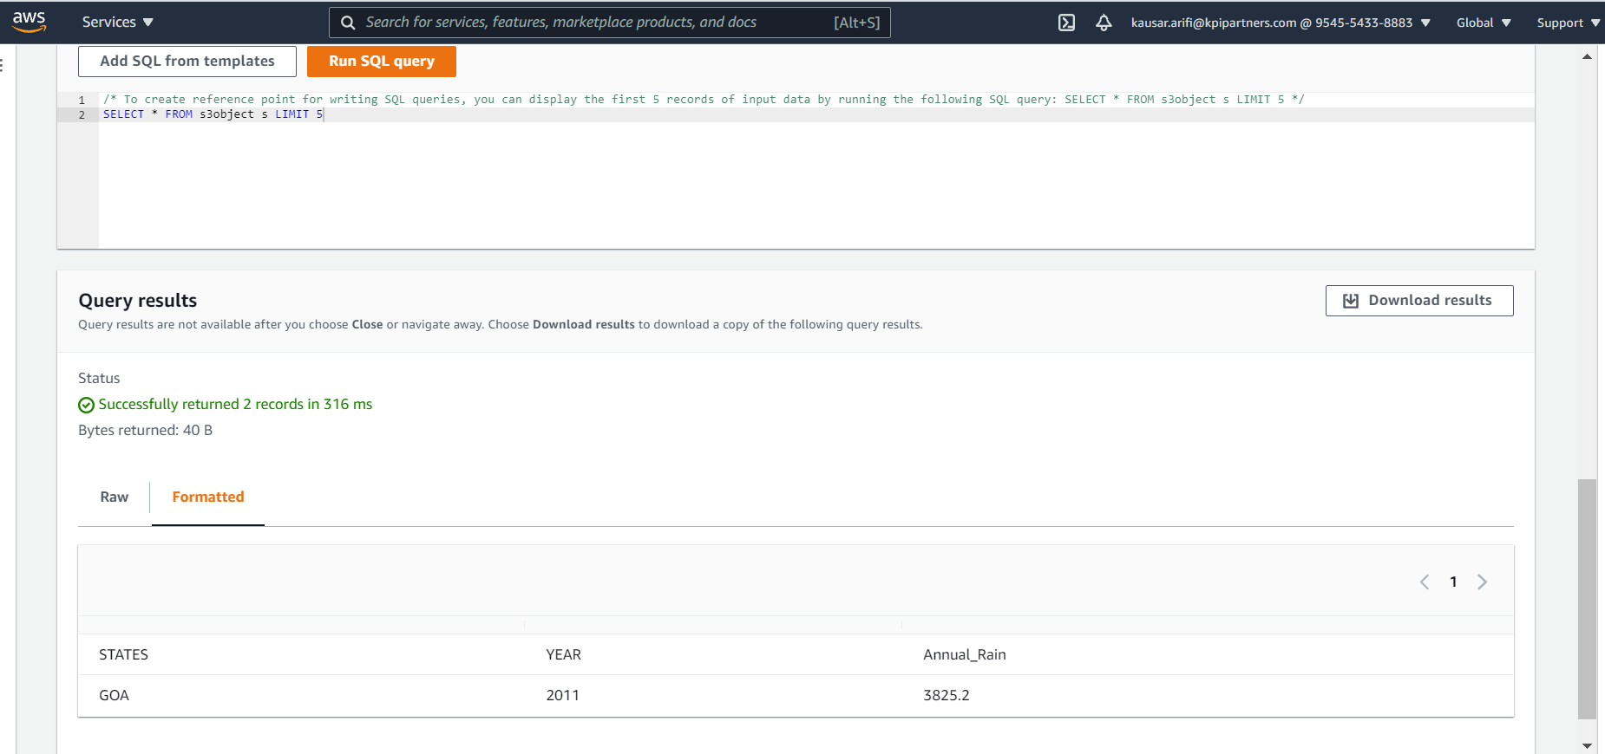
Output:

Slide 24
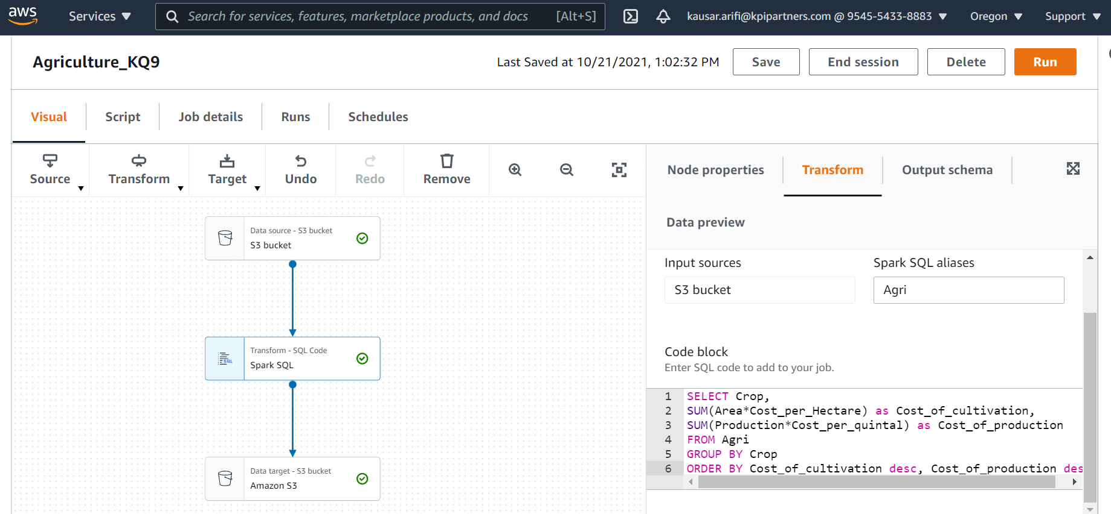
9. Crop wise cost of cultivation versus cost of production

Slide 25
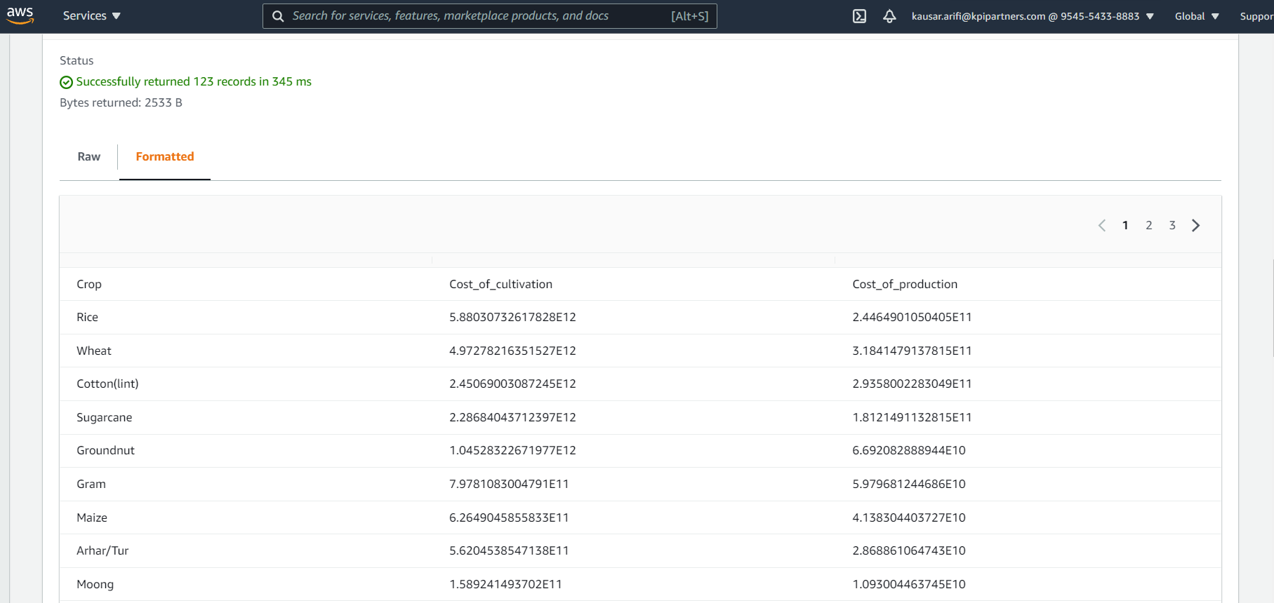
Output:

Slide 26
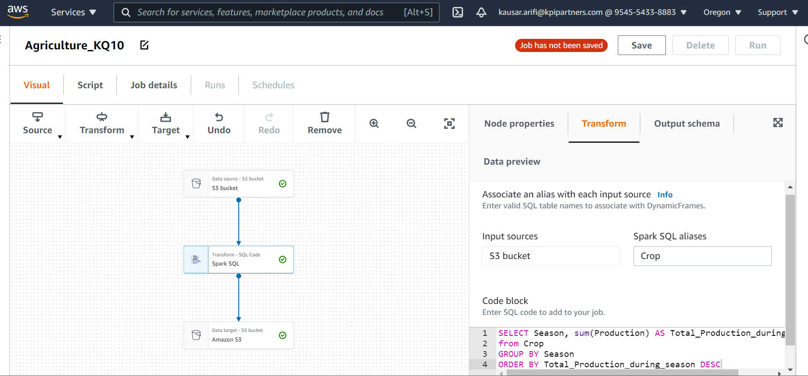
10. Highest crop production in particular season.

Slide 27
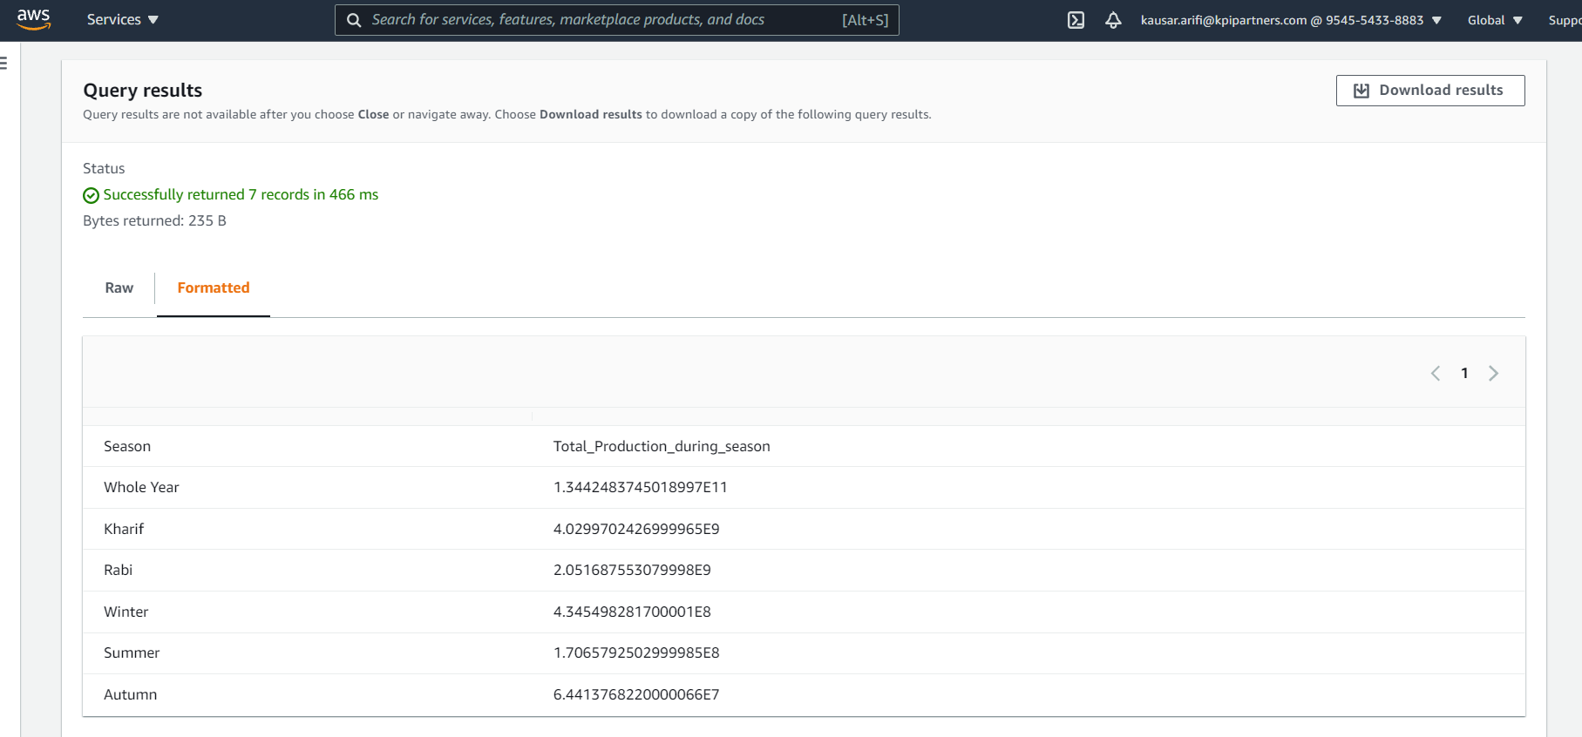
Output:

Slide 28
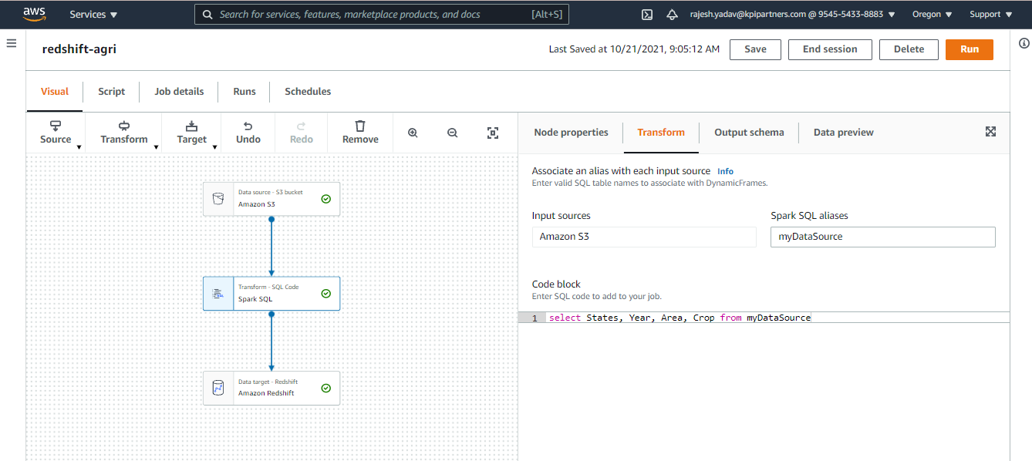
Visualization in Redshift -

Slide 29
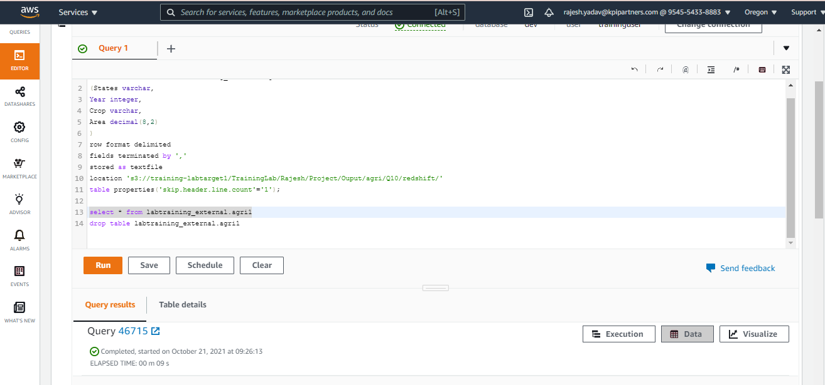
Cont..

Slide 30
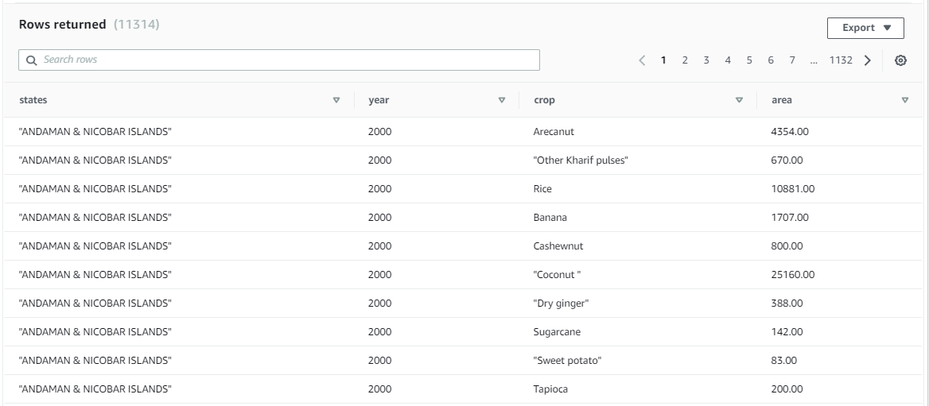
Cont..

Slide 31
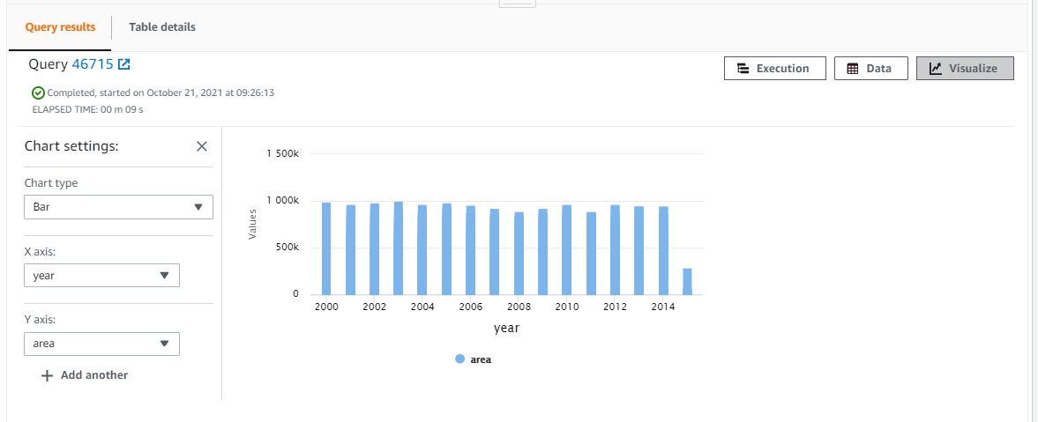
Output:

Slide 32
Using lambda function for transforming dataset and storing the modified dataset into S3 bucket

Slide 33
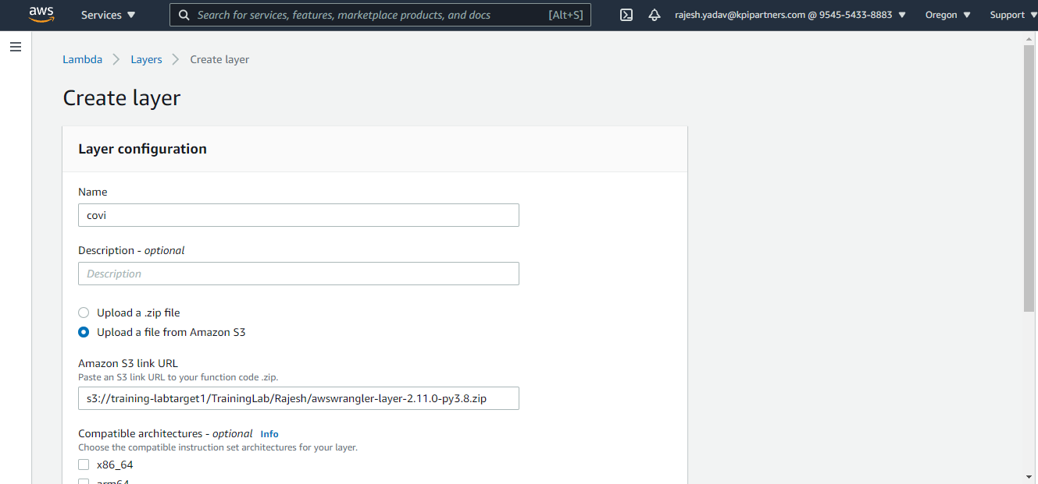
Creating layer for using awswrangler in lambda

Slide 34
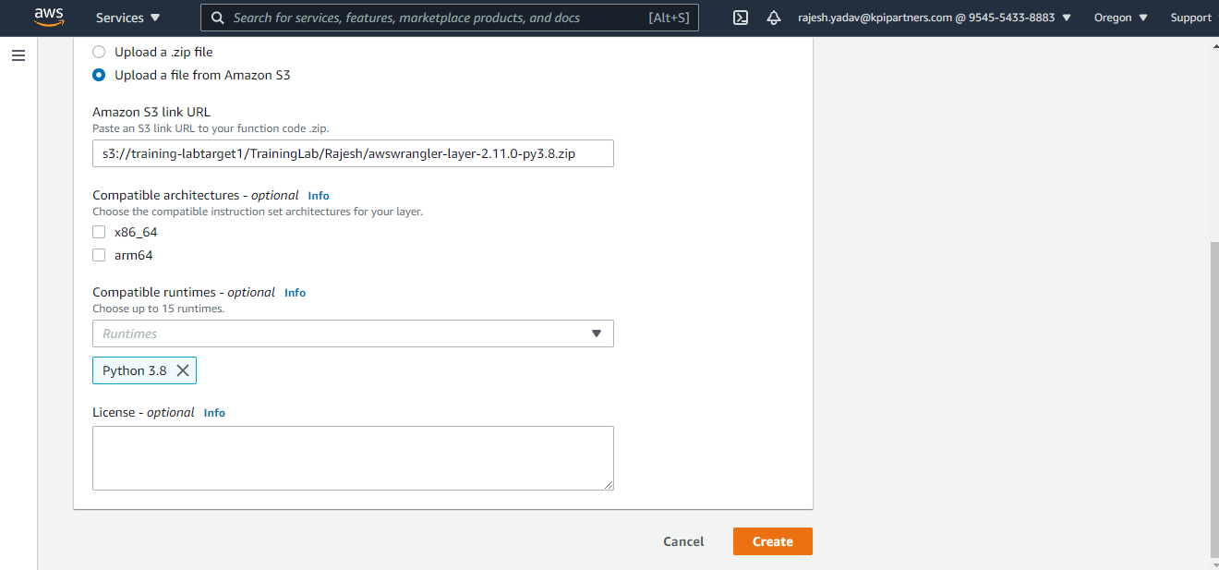
Cont..

Slide 35
Cont..

Slide 36
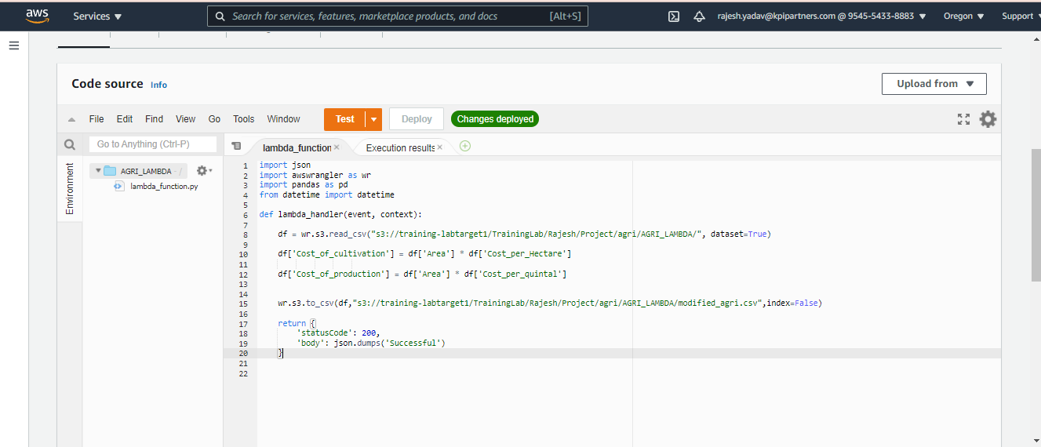
Transformation in lambda- Creating two additional columns

Slide 37
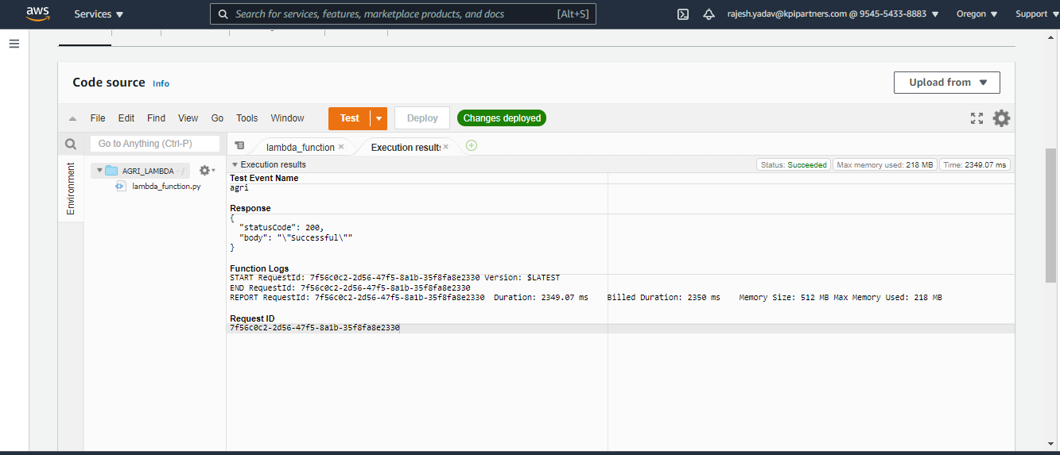
Cont..

Slide 38
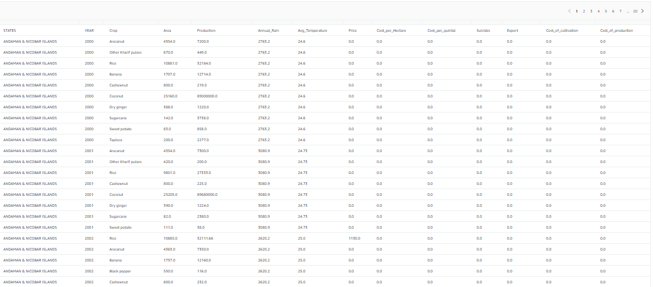
Output:

Slide 39

Thank you.

